Slide 1
BCA CAPSTONE PROJECT (Title Submission) BRAIN TUMOR DETECTION USING MACHINE LEARNING
Submitted to the Presidency University, Bengaluru in partial fulfillment for the award of the degree of Bachelor of Computer Applications(BCA)
Project Team No : 38
Under the supervision of
DR. RAJA JITENDRA NAYAKA
Assistant Professor, Selection Grade
Name | Roll Number
Dhruv Pahal | 20231BCA0260
Vikas V | 20231BCA0262
Bhargav Deekshith | 20231BCA0250
Vaishnavi Satish | 20231BCA0267

Slide 2
Content
Project Title
Abstract
Problem Statement
Literature Reviews
Tools and Technologies to be used
History and Records
Timeline of the Project
Conclusion
Roles and Duties
Workflow

Slide 3
BRAIN TUMOR DETECTION USING MACHINE LEARNING
In this project, we’ll detect the possibility and the type of brain tumor (Glioma, Meningioma, Pituitary and No tumor) using MRI scans with the help of Python and machine learning. We'll start by collecting brain tumor dataset from Kaggle then we'll train a machine learning model using the data and analyze it’s correctiveness and accuracy. Once trained, we'll feed the data into the model to generate accurate predictions.

Slide 4
ABSTRACT
Brain tumors require early and accurate detection to improve patient outcomes. This project addresses the need for an automated system to enhance accuracy and efficiency in brain tumor detection. The objective is to develop a machine learning model that analyzes MRI images and classifies whether a tumor is present, assisting radiologists in making faster and more reliable diagnoses. Using deep learning techniques, particularly convolutional neural networks (CNNs), the model processes MRI scans with advanced image preprocessing techniques such as noise reduction and data augmentation. Implemented in Python with TensorFlow and Keras, the system is trained on labeled MRI datasets to optimize detection accuracy. The expected outcome is a highly accurate and efficient diagnostic tool that reduces false positives and false negatives, ultimately aiding in early diagnosis and improved patient care.

Slide 5
PROBLEM STATEMENT
Brain tumors are a serious medical condition that require early and accurate detection for effective treatment. Traditional diagnostic methods, such as MRI scans, rely heavily on radiologists’ expertise, which can be time-consuming and subject to human error. This project aims to develop a machine learning-based brain tumor detection model using Python to automate and enhance the accuracy of tumor classification. The model will analyze medical imaging data (such as MRI scans) to distinguish between tumor and non-tumor cases, potentially classifying different tumor types. By leveraging deep learning techniques, such as Convolutional Neural Networks (CNNs), this system seeks to provide a fast, efficient, and reliable diagnostic tool to assist medical professionals in detecting brain tumors more accurately.

Slide 6
LITERATURE REVIEWS
1. “Brain Tumor Detection from Images and Comparison with Transfer Learning Models” Published in : Scientific Reports, 2024 This study explores the application of Support Vector Machine (SVM) and K-Nearest Neighbors (KNN) algorithms in classifying brain tumors. The research achieved classification accuracies of 85% with SVM and 88% with KNN, highlighting the potential of machine learning techniques in medical diagnostics. Source : https://www.nature.com/articles/s41598-024-52823-9
2. “A Review of Recent Advances in Brain Tumor Diagnosis Based on Machine Learning Approaches” Published in : Journal of Imaging, 2023 This comprehensive review discusses various machine learning and deep learning methodologies for brain tumor detection and classification. It covers topics such as types of brain tumors, available datasets, image enhancement methods, segmentation techniques, feature extraction, and classification models, providing a holistic view of the current state of research in this domain. Source : https://pmc.ncbi.nlm.nih.gov/articles/PMC10527911

Slide 7
LITERATURE REVIEWS
3. “Brain Tumor Detection Using Machine and Deep Learning” Published in : Multimedia Tools and Applications, 2024 This paper provides an exhaustive examination of the latest techniques employed for diagnosing brain tumors from MRI images. It emphasizes the utilization of machine learning and deep learning models, discussing their advantages, limitations, and potential future developments in the field. Source : https://link.springer.com/article/10.1007/s11042-024-19333-2
4. “A Systematic Review on Brain Tumor Detection Using Deep Learning” Published in : AIP Conference Proceedings, 2023 This comprehensive review discusses various machine learning and deep learning methodologies for brain tumor detection and classification. It covers topics such as types of brain tumors, available datasets, image enhancement methods, segmentation techniques, feature extraction, and classification models, providing a holistic view of the current state of research in this domain. Source : https://pmc.ncbi.nlm.nih.gov/articles/PMC10527911

Slide 8
LITERATURE REVIEWS
5. “A Literature Review on Brain Tumor Detection and Segmentation” Published in : IEEE Access, 2021 This extensive review focuses on the sub-field of brain tumor detection, with a primary emphasis on segmentation techniques. It offers a detailed guide to various methodologies, discussing their effectiveness, challenges, and the future direction of research in brain tumor segmentation. Source : https://ieeexplore.ieee.org/document/9432342
6. “Brain Tumor Detection and Classification Using Machine Learning” Published in: Complex & Intelligent Systems, 2021 This survey compiles significant literature on brain tumor detection, outlining various machine learning approaches. It discusses the benefits and drawbacks of each method, recent developments, and anticipates future trends in the application of machine learning for brain tumor analysis. Source : https://link.springer.com/article/10.1007/s40747-021-00563-y

Slide 9
MODULE DESIGN
Overview: The brain tumor detection project is structured into multiple modules to ensure a systematic and efficient workflow. By dividing the project into distinct stages, such as data collection, model training, and result analysis, the system can handle complex medical imaging tasks effectively. Each module plays a crucial role in transforming raw MRI scan data into meaningful diagnostic insights using machine learning techniques.
Purpose of Division: Dividing the project into modules enhances scalability, maintainability, and efficiency. It allows for easier debugging, parallel development, and improved performance optimization. This modular approach ensures that each part of the pipeline—data processing, feature extraction, and classification—can be fine-tuned independently, leading to better accuracy and reliability in brain tumor detection.

Slide 10
MODULE DESIGN
Modular Breakdown
Module 1: Data Collection & Preprocessing – This module involves gathering MRI scan datasets, cleaning the images, performing normalization, and applying augmentation techniques. Preprocessing ensures that the data is optimized for model training, improving accuracy and generalization.
Module 2: Feature Extraction & Model Training – This stage extracts key features from MRI images using deep learning techniques such as Convolutional Neural Networks (CNNs). The model is trained on labeled datasets to learn tumor patterns and make accurate classifications.
Module 3: Classification & Output Analysis – Once trained, the model classifies new MRI images as tumor or non-tumor cases. Performance evaluation metrics such as accuracy, precision, recall, and F1-score are used to measure the effectiveness of the model. Additional techniques like Grad-CAM visualization enhance interpretability by highlighting key regions in the image influencing the model’s decision.

Slide 11
TOOLS AND TECHNOLOGIES TO BE USED
Development Tools: Visual Studio Code, Google Colab
Programming Languages: Python, HTML, JavaScript, CSS
Frameworks/Libraries: Numpy, TensorFlow, Keras
Additional Tools: Kaggle

Slide 12
GITHUB LINK
GitHub Repository Link:
https://github.com/dhruv-pahal/BrainTumorDetection.git

Slide 13
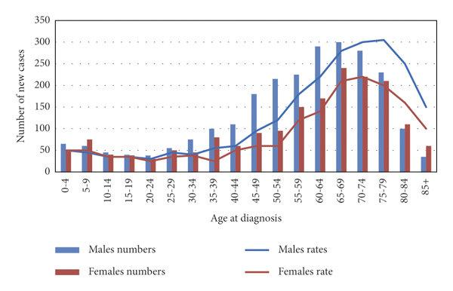
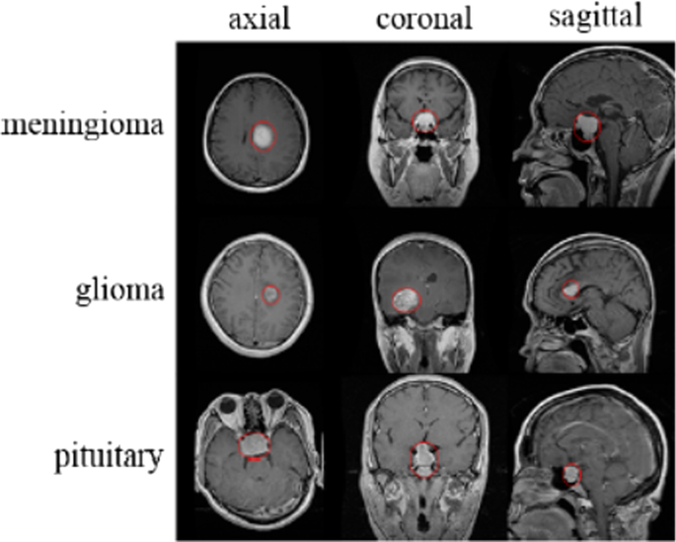
HISTORY AND RECORDS
The graph illustrates the distribution of brain tumor cases across different age groups, categorized by gender. The bar charts represent the number of cases for males (blue) and females (red), while the line graphs indicate the respective incidence rates. The data suggests a gradual increase in brain tumor cases with age, peaking between 65-74 years, followed by a decline in older age groups. Males show a consistently higher number of cases compared to females, particularly in the older age brackets. These insights highlight the importance of age as a significant factor in brain tumor prevalence and can aid in targeted early diagnosis and intervention strategies.

Slide 14
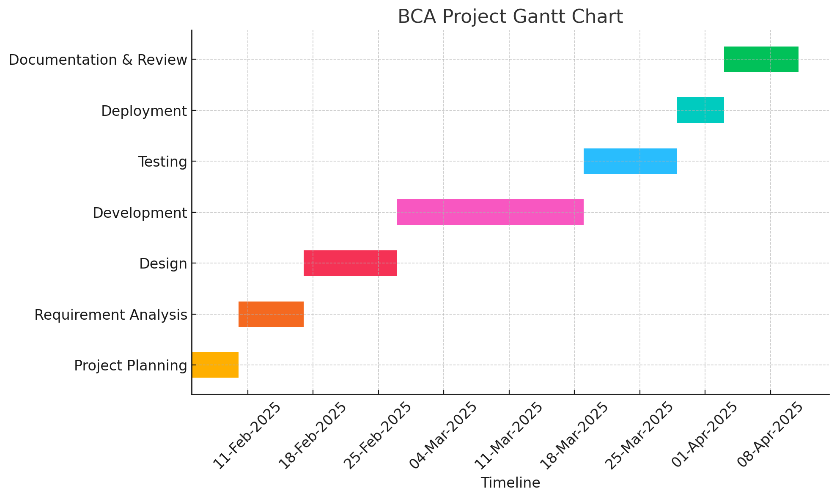
Timeline of the Project (Gantt Chart)
Mention the dates according to the phases of your project.
Refer Project Review Schedule for Dates.

Slide 15
REFERENCES(IEEE PAPER FORMAT)
S. Pereira, A. Pinto, V. Alves, and C. A. Silva, "Brain Tumor Segmentation Using Convolutional Neural Networks in MRI Images," IEEE Transactions on Medical Imaging, vol. 35, no. 5, pp. 1240–1251, May 2016. [Online]. Available: https://ieeexplore.ieee.org/document/7423673

Slide 16
CONCLUSION
This project demonstrates the effectiveness of machine learning, particularly CNNs, in detecting brain tumors from MRI scans with high accuracy. By automating the diagnostic process, it enhances efficiency, reduces human error, and supports early treatment decisions. Future improvements, such as larger datasets and real-world testing, can further refine its reliability for medical use.

Slide 17
ROLES AND DUTIES
NAME | DUTIES
Dhruv Pahal(20231BCA0260) | Source Code & Algorithms
Vikas V(20231BCA0262) | Research & Development
Bhargav Deekshith(20231BCA0250) | Source Code & Website Development
Vaishnavi Satish(20231BCA0267) | Research & Development

Slide 18
WORK FLOW
Starting from 3rd March 2025(Monday), we have approx. 7 months to complete the project and get it corrected with our guide. So here’s a workflow of how we’re going to work as a team and make this a successful project within the deadline.
NAME | 1st WEEK | 2nd-5th WEEK | 6th WEEK | 7th WEEK
DHRUV PAHAL | Resource Collection | Coding and dev. | Testing | Review and updation
VIKAS V | Resource Collection | Prepare Documents | Testing | Review and updation
BHARGAV DEEKSHITH | Resource Collection | Coding and dev. | Testing | Review and updation
VAISHNAVI SATISH | Resource Collection | Prepare Documents | Testing | Review and updation

Slide 19


